Slide 1
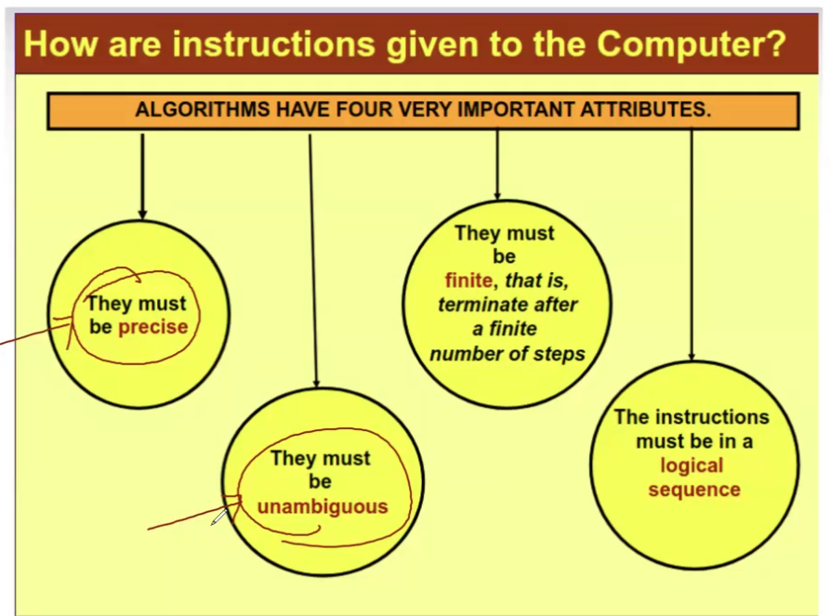

Slide 2

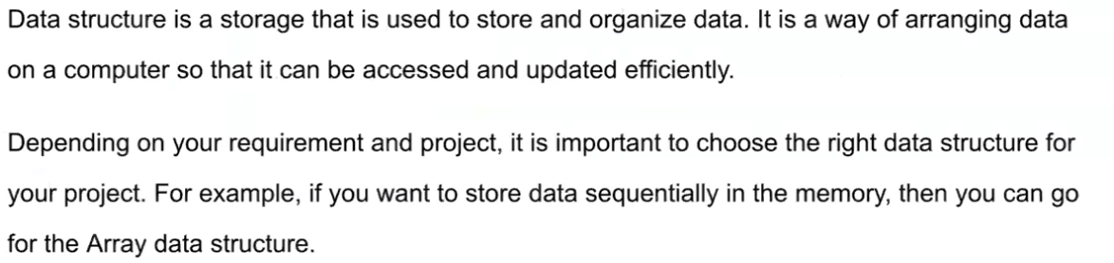


Linear Data Structures: Arrays, Linked Lists, Stacks, Queues, Strings.
Linear Data Structures: Arrays, Linked Lists, Stacks, Queues, Strings.
Linear Data Structures: Arrays, Linked Lists, Stacks, Queues, Strings.
Non-Linear Data Structures: Trees, Graphs.
Hash-Based Data Structures: Hash Tables, Sets.
Advanced Data Structures: Skip Lists, Suffix Trees/Arrays, Segment Trees, Fenwick Trees.

Slide 3
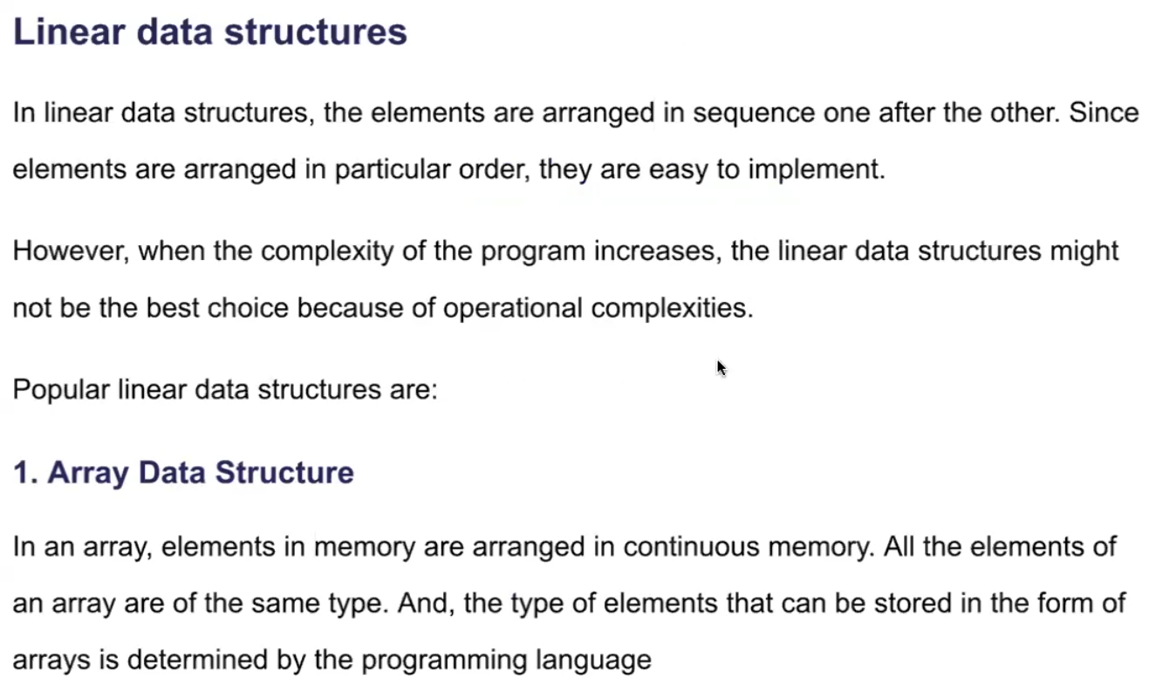
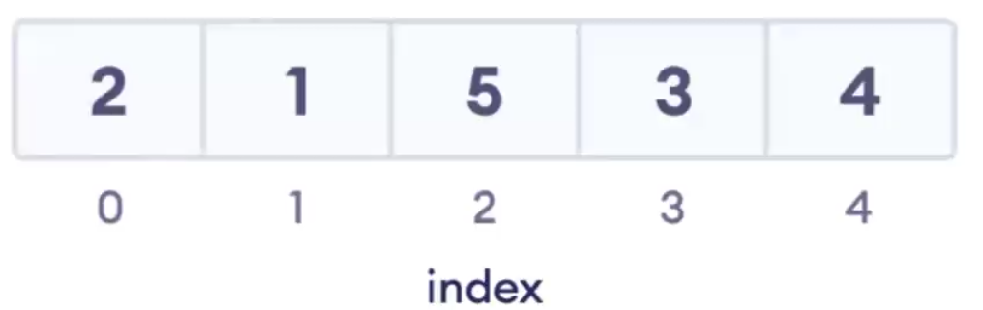
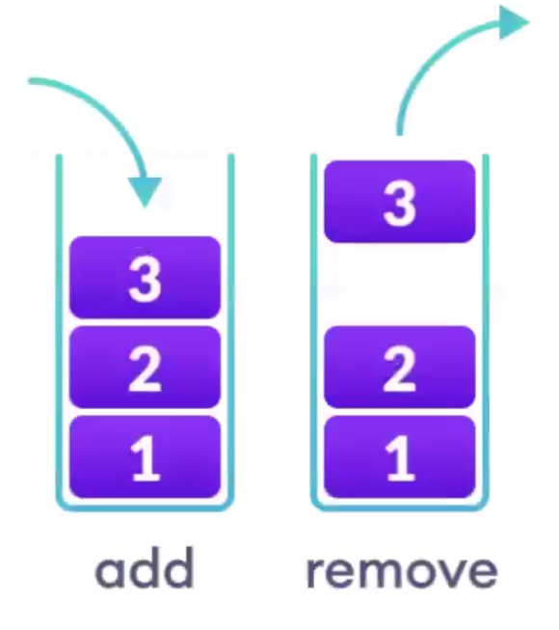
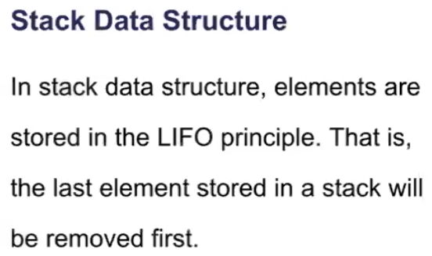

Slide 4
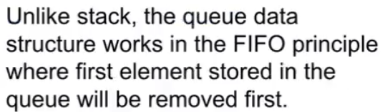
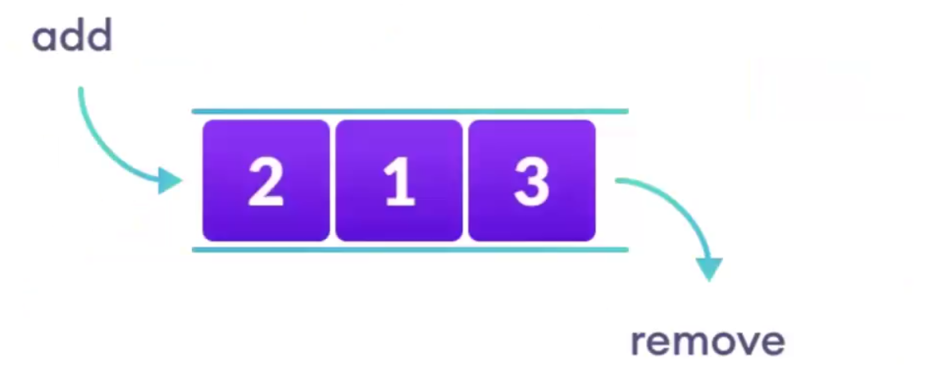
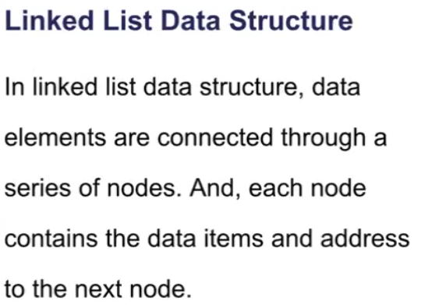


Slide 5
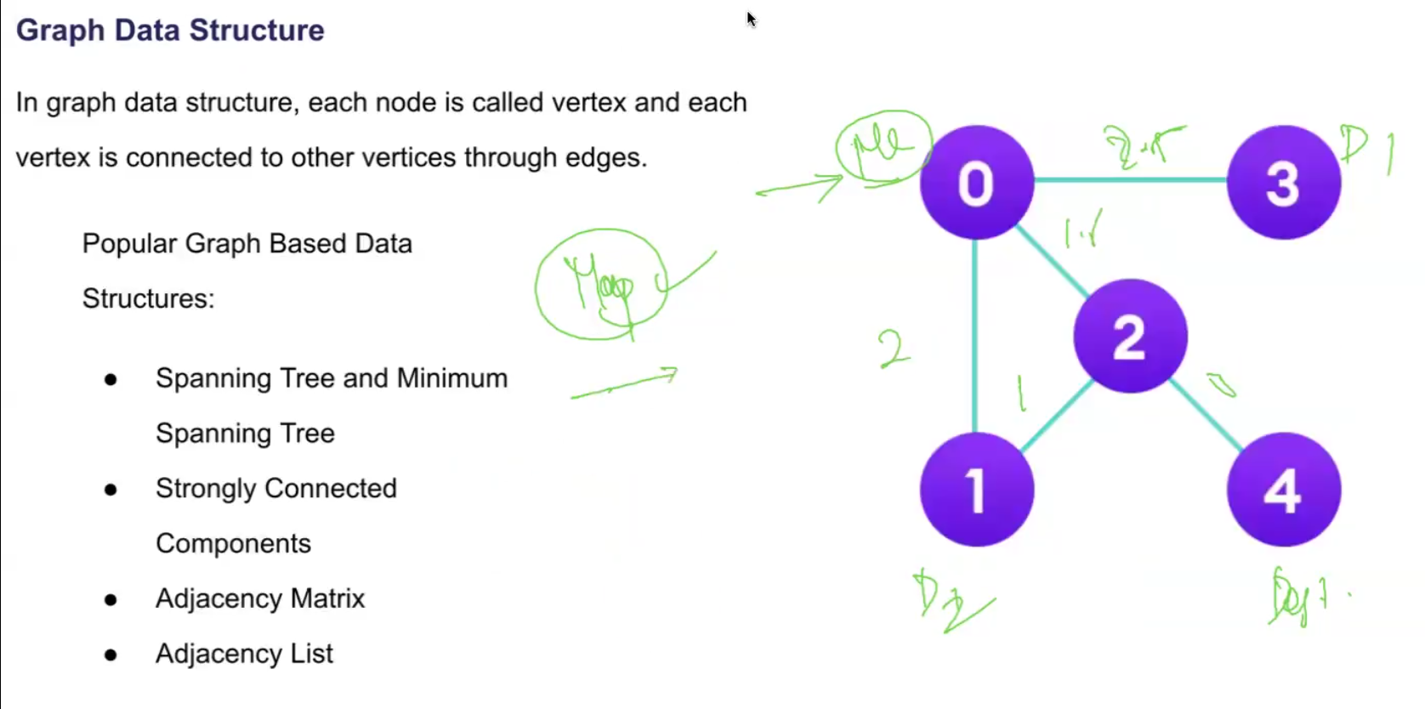
Used majorly for MAPS ,

Slide 6
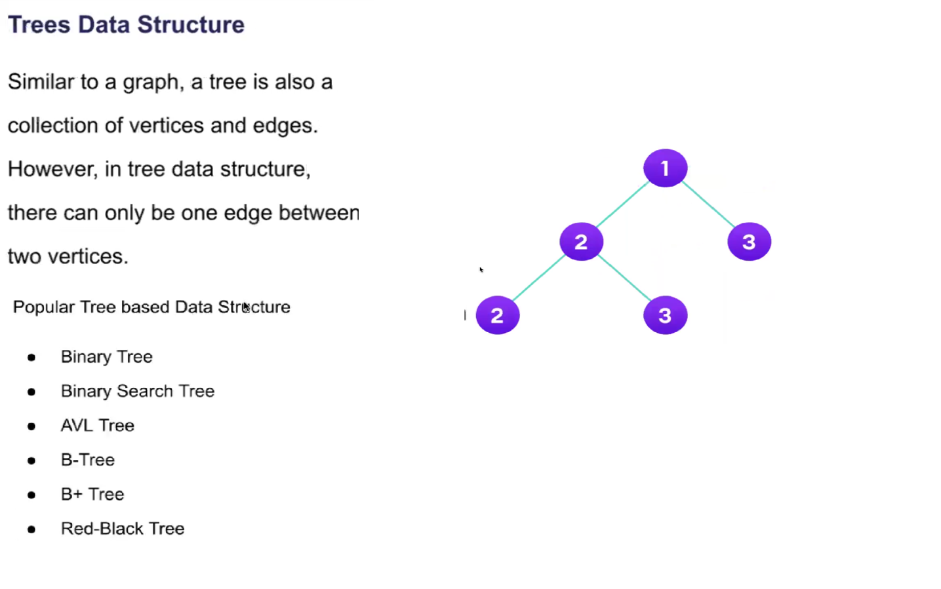

Slide 7

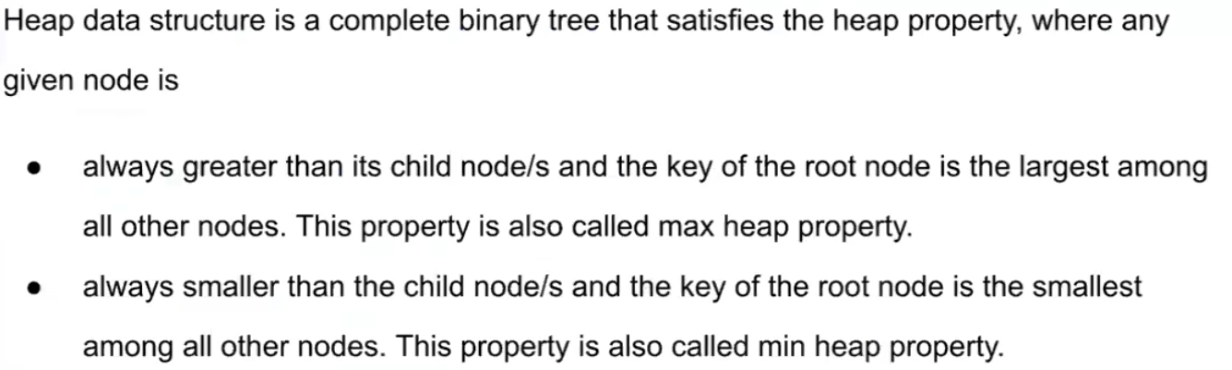

Slide 8

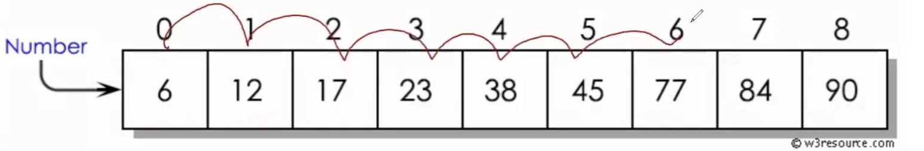
Binary search is an efficient algorithm used to find an element in a sorted array or list. It works by repeatedly dividing the search interval in half and comparing the target value to the middle element of the current interval. If the target value is equal to the middle element, the search is complete. If the target value is less than or greater than the middle element, the search continues in the corresponding half of the array. This process continues until the target value is found or the interval is empty
Steps of Binary Search
Initialize Pointers: Start with two pointers, low and high, representing the current interval's boundaries. Initially, low is set to 0 (the start of the array), and high is set to the length of the array minus one (the end of the array).
Calculate Midpoint: Find the middle index mid of the current interval using:
Compare and Narrow Down:
If the target value equals the middle element: The search is successful, and the index of the middle element is returned.
If the target value is less than the middle element: Narrow the search to the left half of the array by setting high to mid - 1.
If the target value is greater than the middle element: Narrow the search to the right half of the array by setting low to mid + 1.
Repeat: Continue the process until low exceeds high (indicating the target value is not in the array) or until the target value is found.

Slide 9
